Slide 1
Kubernetes Workloads & Scheduling
Cloud Native Bootcamp - Karachi

Slide 2


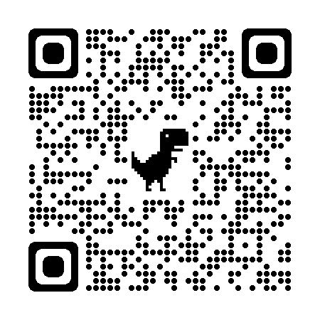
Bashir Ahmed Zeeshan
\bashirahmedzeeshan
Post Graduated in Telecommunication
Enthusiast of academic & industry liaison
Lead 55+ training session for Zong CMPak, Huawei, & QUBEE
Supervised 30+ Final Year Projects at Open House FAST - NUCES ,SMIU & PAK-KIET
Mentoring session by IEEE NUST PNEC, NED, FAST, UIT

Slide 3
Roadmap
Kubernetes
Intro
Kubernetes
History & Current status
Hands On
1
3
5
2
4
6
Why we need it?
In dept K8s
Recap &
Q/A

Slide 4
Road Map
Kubernetes
Workloads & Scheduling
Hands on & Project
Q/A and Discussion

Slide 5
Kubernetes

Slide 6
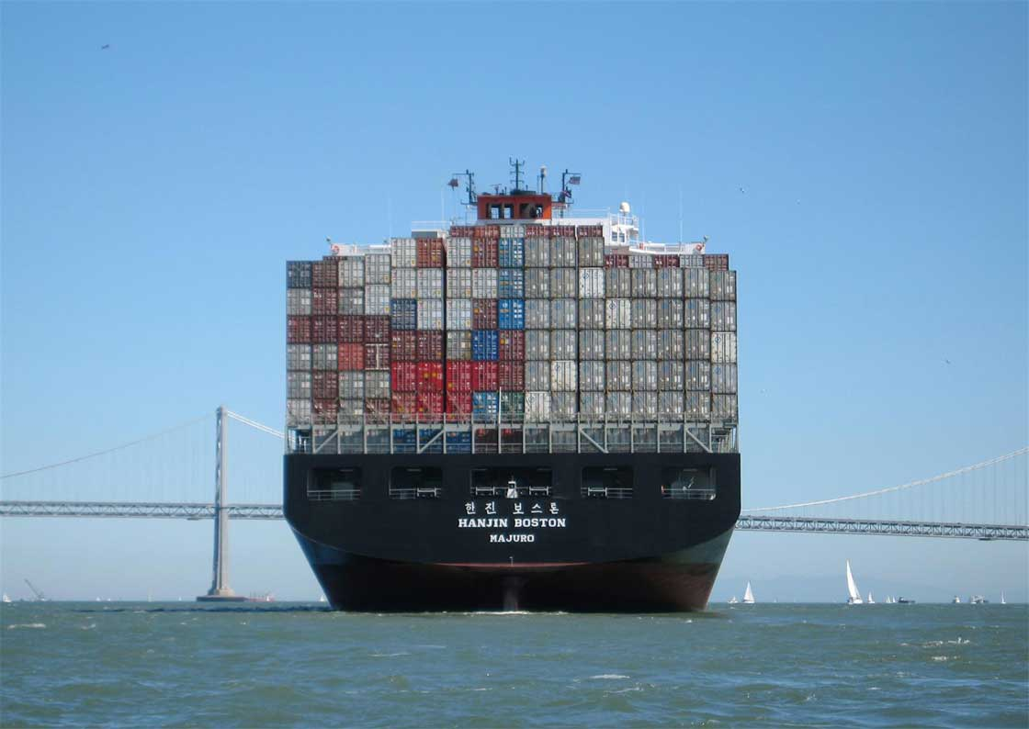
Google is running
Two Billion (2 000 000 000)
Containers per week !!!

Slide 7
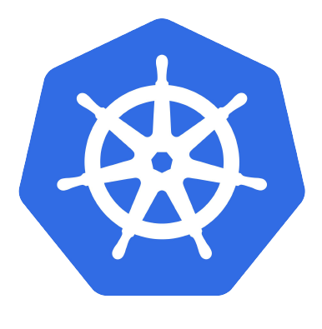
Kubernetes
K8s is an open-source container management system for automating deployment, operations, scaling of containerized applications and creating clusters of containers.
Production-Grade Container Orchestration System

Slide 8
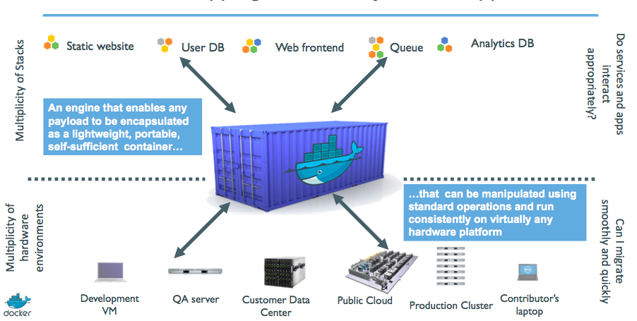
K8’s Big Picture

Slide 9
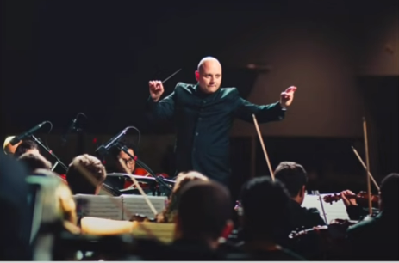
What really Kubernetes is?

Slide 10
How its all done!

Slide 11
Worker
Master
Notes:
– kube-apiserver ● Exposes the Kubernetes API – the front-end for the Kubernetes control plane. ● Designed to scale horizontally.
– etcd ● Is the backing store of Kubernetes. ● Distributed key-value store
– Kube-controller-manager ● background threads that handle routine tasks
– Node Controller, – Replication Controller, – Endpoints Controller – Service Account & Token Controllers
– kube-scheduler ● Assigns nodes to the newly created pods
– kubelet - the primary node agent. It watches for pods that have been assigned to its node and:
● Mounts the pod’s required volumes. ● Downloads the pod’s secrets. ● Runs the pod’s containers. ● Periodically executes any requested container liveness probes.
● Reports the status of the pod. ● Reports the status of the node.
– kube-proxy ● enables the Kubernetes service abstraction by maintaining network rules on the host and performing connection forwarding
– Container engine ● Used to run the containers ● Docker by default, rkt optionally. ● Container Runtime Interface – paves the way to alternative runtimes

Slide 12
Workloads
Some common workloads

Slide 13
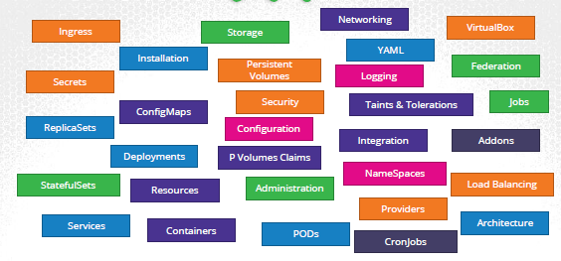
Intro of Workload
an application running on Kubernetes
Can be a single component or several that work together,
A lonely Pod
Grouped ones
defined lifecycle
Ensure reliability
Notes:
A workload is an application running on Kubernetes
Whether your workload is a single component or several that work together, on Kubernetes you run it inside a set of pods In Kubernetes, a Pod represents a set of running containers on your cluster
Kubernetes pods have a defined lifecycle For example, once a pod is running in your cluster then a critical
fault on the node where that pod is running means that all the pods on that node fail Kubernetes treats
that level of failure as final you would need to create a new Pod to recover, even if the node later becomes
Healthy
However, to make life considerably easier, you don't need to manage each Pod directly Instead, you can
use workload resources that manage a set of pods on your behalf These resources configure controllers
that make sure the right number of the right kind of pod are running, to match the state you specified

Slide 14
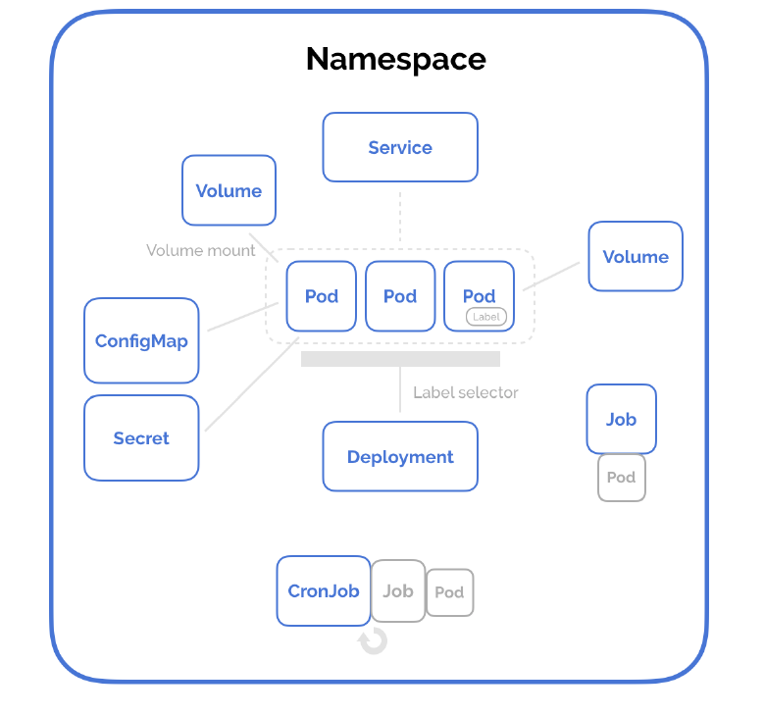
Resources
Pod
Deployment
Job/CJ
CM /Secrets
Demonset
Services /NS
…Volumes

Slide 15
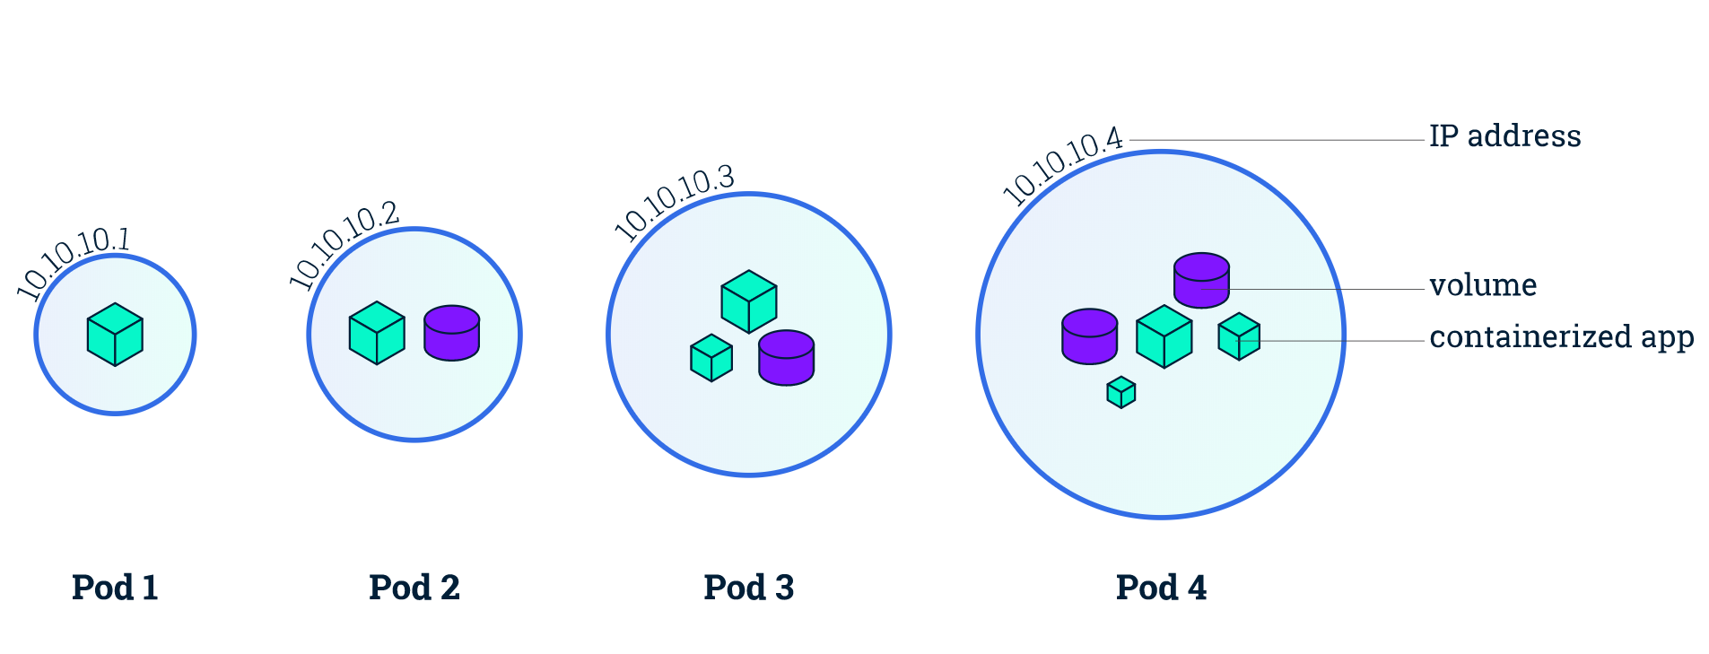
Pod
Smallest deployable units
Pods are usually not created directly. Instead, create them using workload resources such as Deployment or Job or StatefulSets
kubectl run nginx --image nginx
apiVersion: v1
kind: Pod
metadata:
name: simple-webapp
labels:
app: App1
spec:
containers:
- name: nginx
image: nginx
ports:
- containerPort: 8080
Notes:
Pods are the smallest deployable units of computing that you can create and manage in Kubernetes. The whole point of Kubernetes is to orchestrate the lifecycle of a container.
Share context:
Linux Namespaces
Cgroups

Slide 16
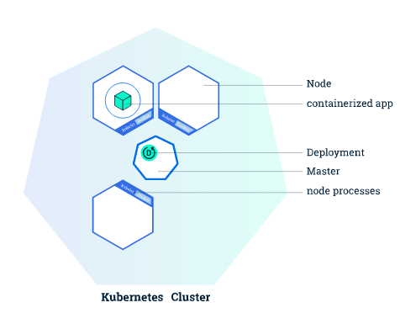
Deployment
Provides declarative updates for Pods & RS
Describe the desired state and the deployment Controller will match the actual state to the desired state
apiVersion: apps/v1
kind: Deployment
metadata:
name: nginx-deployment
labels:
app: nginx
spec:
replicas: 3
selector:
matchLabels:
app: nginx
template:
metadata:
labels:
app: nginx
spec:
containers:
- name: nginx
image: nginx:1.14.2
ports:
- containerPort: 80
Imperative
$ kubectl create deployment nginx-deploy ---image=nginx
Declarative
$ kubectl apply -f deployment-def.yaml
Notes:
Create a Deployment to rollout a ReplicaSet
Declare the new state of the Pods
Rollback to an earlier Deployment revision
Scale up the Deployment to facilitate more load
Pause the Deployment

Slide 17
Pod / Replicatset / Deployment Structure
apiVersion: v1
kind: Pod
metadata:
spec:
apiVersion: apps/v1
kind: Deployment
metadata:
spec:
template:
pod-structure
replicas:
selector:
matchLabels:
apiVersion: apps/v1
kind: ReplicaSet
metadata:
spec:
template:
pod-structure
replicas:
selector:
matchLabels:

Slide 18
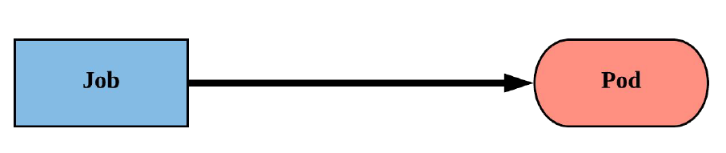
Job
Job controller ensures one or more pods are executed
and successfully terminate.
Will continue to try and execute the job until it satisfies the completion
Pods are NOT cleaned up until the job itself is deleted.*
apiVersion : batch/v1
kind: Job
metadata :
name: whalesay
spec:
template :
spec:
containers :
- name: whalesay
image: docker/whalesay
command: ["cowsay" , “k8S!"]
restartPolicy : Never
backoffLimit : 4
activeDeadlineSeconds : 60
Notes:
backoffLimit specify the number of retries before considering a Job as failed
○ 6 is default retries set back-off limit by kubernetes
○ Failed Pods associated with the Job are recreated by the Job controller with an
exponential back-off delay (10s, 20s, 40s …) capped at six minutes
○ The back-off count is reset if no new failed Pods appear before the Job’s next
status check
● activeDeadlineSeconds applies to the duration of the job, once a Job reaches
activeDeadlineSeconds, all of its Pods are terminated and the Job status will become
type: Failed with reason: DeadlineExceeded

Slide 19
CronJobs
similar to Kubernetes Job resource
Only difference is Job resource create Pod to perform instantly and do not reinitiates the job once completed successfully
CronJob resource is used to schedule Job at later time and can be set to initiate the Job again on provided time gap
CronJob always creates only a single Job resource for each execution
configured in the schedule
minute [0,59]
hour [0,23]
day of the month [1,31]
month of the year [1,12]
day of the week ([0,6] with 0=Sunday)

Slide 20
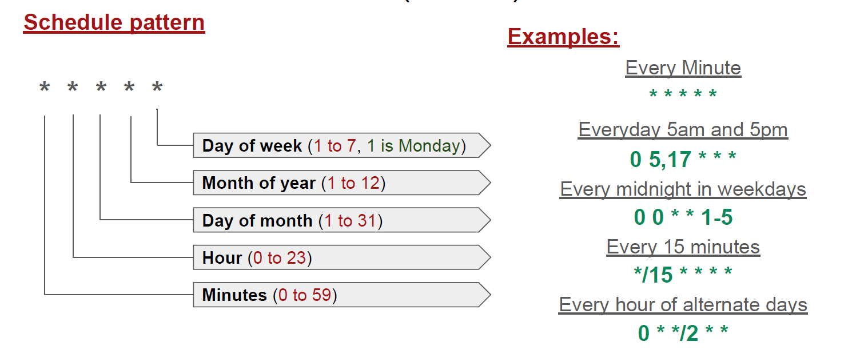
Cron Jobs

Slide 21
ConfigMaps
an API object used to store non-confidential data in key-value pairs.
Pods can consume ConfigMaps as environment variables, command-line arguments, or as configuration files in a volume.
Has a data field rather than spec in the definition
Declarative
cm-definition.yaml
apiVersion: v1
kind: ConfigMap
metadata:
name: game-config-env-file
data:
allowed: '"true"'
enemies: aliens
lives: "3"
$ kubectl apply -f cm-definition.yaml

Slide 22
Secret:
Secrets provides a way to distribute credentials, keys, passwords or “secret” data to the pods
Kubernetes itself uses this Secrets mechanism to provide the credentials to access the internal API
Kubernetes Secrets let you store and manage sensitive information, such as passwords, OAuth tokens, and ssh keys.
pod-secret.yaml
apiVersion: v1
kind: Pod
metadata:
name: env-single-secret
spec:
containers:
- name: envars-test-container
image: nginx
env:
- name: SECRET_USERNAME
valueFrom:
secretKeyRef:
name: backend-user
key: backend-username
$ kubectl create secret generic backend-user --from-literal=backend-username='backend-admin'

Slide 23
DaemonSet:
ensures that all (or some) nodes run a copy of a Pod.
As nodes are added to the cluster, Pods are added.
As nodes are removed from the cluster, those Pods are garbage collected.
Deleting a DaemonSet will clean up the Pods it created.
Use Cases:
Node monitoring daemon: collectd
Log collection daemon: fluentd, filebeat
kube-proxy
Networking: Weave-net
DaemonSet Structure:
It is as same as ReplicaSet.
pod-ds.yaml
apiVersion: apps/v1
kind: DaemonSet
metadata:
name: nginx-ds
spec:
template:
metadata:
name: nginx-ds-app
labels:
app: nginx-agent
spec:
containers:
- name: nginx-ds
image: nginx
selector:
matchLabels:
app: nginx-agent

Slide 24
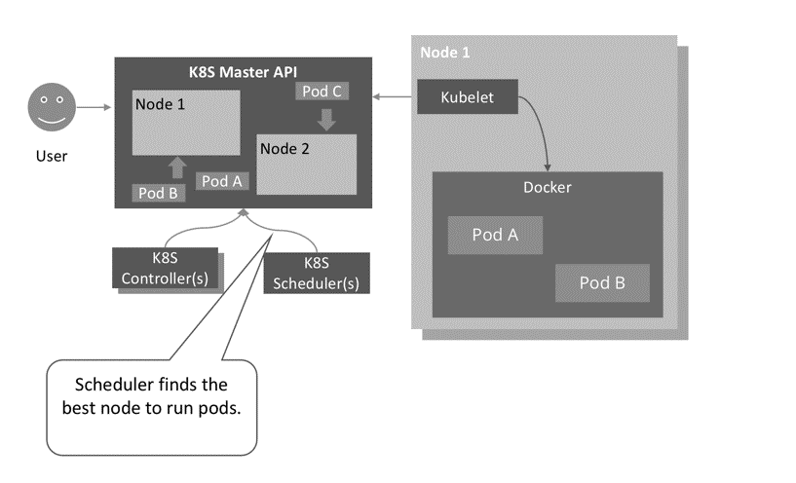
Scheduling
refers to making sure that Pods are matched to Nodes so that Kubelet can run them
kube-scheduler is the default scheduler
Node selection in kube-scheduler
Filtering
Scoring
Manual Scheduling
Static Pod
Notes:
scheduling refers to making sure that Pods are matched to Nodes so that Kubelet can run them
The filtering step finds the set of Nodes where it's feasible to schedule the Pod | scoring step, the scheduler ranks the remaining nodes to choose the most suitable Pod placement.
https://k21academy.com/docker-kubernetes/scheduling-in-kubernetes/
Some Pod Schedule Methods
Node Selector
Node Affinity/Anti-Affinity
Taints and Tolerations

Slide 25
Static Pod
Static Pods are managed directly by the kubelet daemon on a specific node, without the API Server observing them. Static Pods are always bound to one kubelet on a specific node.
Static pods are usually used by software bootstrapping kubernetes itself.
Creation Process:
systemctl status kubelet ( see filename under --config parameter )
sudo ls -altr /var/lib/kubelet/config.yaml
sudo cat /var/lib/kubelet/config.yaml | grep stat
Create Pod definition file under directory shown in by above command.

Slide 26
Multi Tier Application
It is an application distributed among more than one layer.
It logically separates the operational layers. In this, application divided into 3 layers backend, middle and frontend layer.
Database
Rest API
Web
Frontend
middle
Backend
Notes:
A multi-tier application is an application distributed among more than one layer. It logically separates the operational layers. The number of layers varies with business and application requirements. In this, application divided into 2 layers, backend and frontend layer. We will use MongoDB as a backend to store data and Python Flask as a frontend Webserver. We will deploy these two applications using deployments in Kubernetes and have services to forward requests to them.

Slide 27
Workloads
db
Go Web app
Service
Deployment
Postgres db
Deployment
Service
words
Java Rest API
Deployment
Service
web

Slide 28
Task Explained
Wordsmith is the demo project shown at DockerCon EU 2017 and 2018.
The demo app runs across three containers:
**db** - a Postgres database which stores words
**words** - a Java REST API which serves words read from the database
**web** - a Go web application which calls the API and builds words into sentences:

Slide 29
Database
apiVersion: v1
kind: Service
metadata:
name: words
labels:
app: words-api
spec:
ports:
- port: 8080
targetPort: 8080
name: api
selector:
app: words-api
clusterIP: None
apiVersion: v1
kind: Service
metadata:
name: db
labels:
app: words-db
spec:
ports:
- port: 5432
targetPort: 5432
name: db
selector:
app: words-db
clusterIP: None
---
API
apiVersion: apps/v1
kind: Deployment
metadata:
name: db
labels:
app: words-db
spec:
selector:
matchLabels:
app: words-db
template:
metadata:
labels:
app: words-db
spec:
containers:
- name: db
image: dockersamples/k8s-wordsmith-db
ports:
- containerPort: 5432
name: db
apiVersion: apps/v1
kind: Deployment
metadata:
name: words
labels:
app: words-api
spec:
replicas: 5
selector:
matchLabels:
app: words-api
template:
metadata:
labels:
app: words-api
spec:
containers:
- name: words
image: dockersamples/k8s-wordsmith-api
ports:
- containerPort: 8080
name: api

Slide 30
apiVersion: v1
kind: Service
metadata:
name: web
labels:
app: words-web
spec:
ports:
- port: 8081
targetPort: 80
name: web
selector:
app: words-web
type: LoadBalancer
Web App
apiVersion: apps/v1
kind: Deployment
metadata:
name: web
labels:
app: words-web
spec:
selector:
matchLabels:
app: words-web
template:
metadata:
labels:
app: words-web
spec:
containers:
- name: web
image: dockersamples/k8s-wordsmith-web
ports:
- containerPort: 80
name: words-web

Slide 31
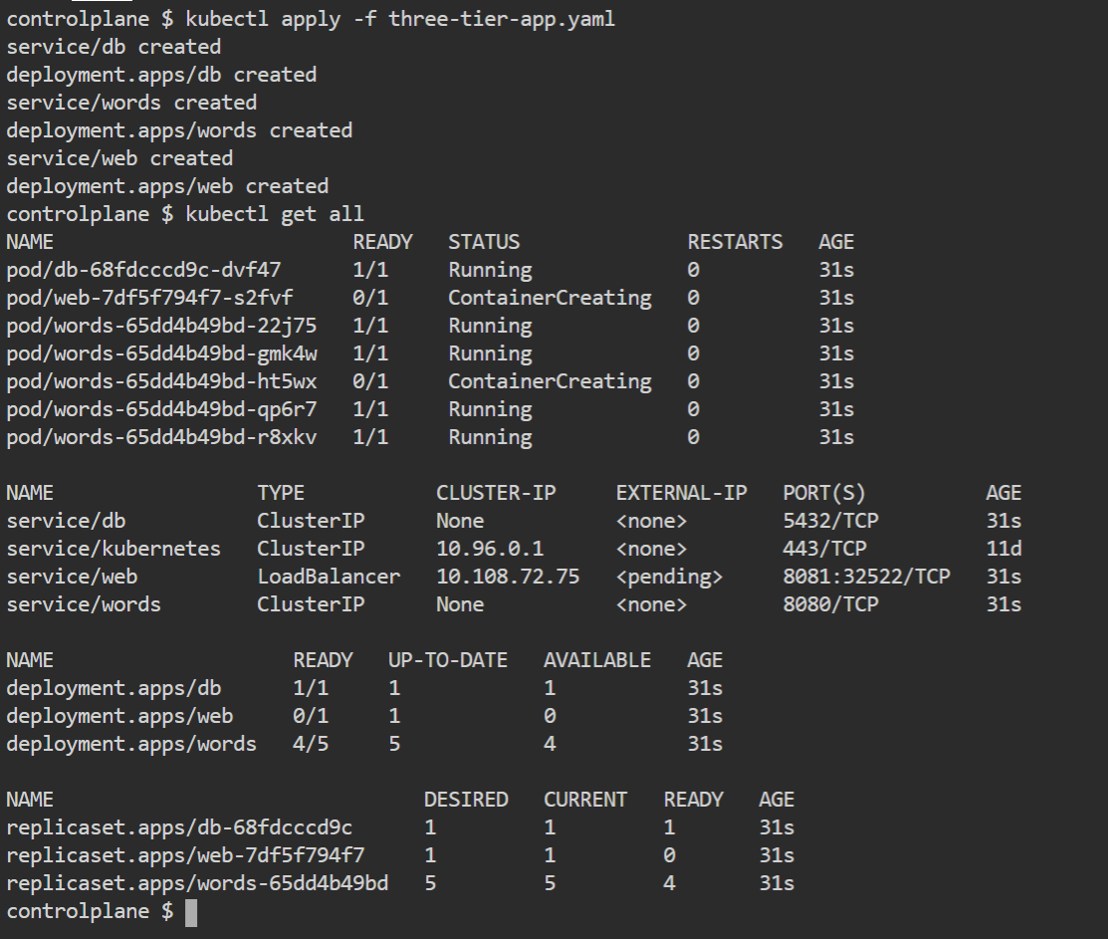
Deployment Steps

Slide 32
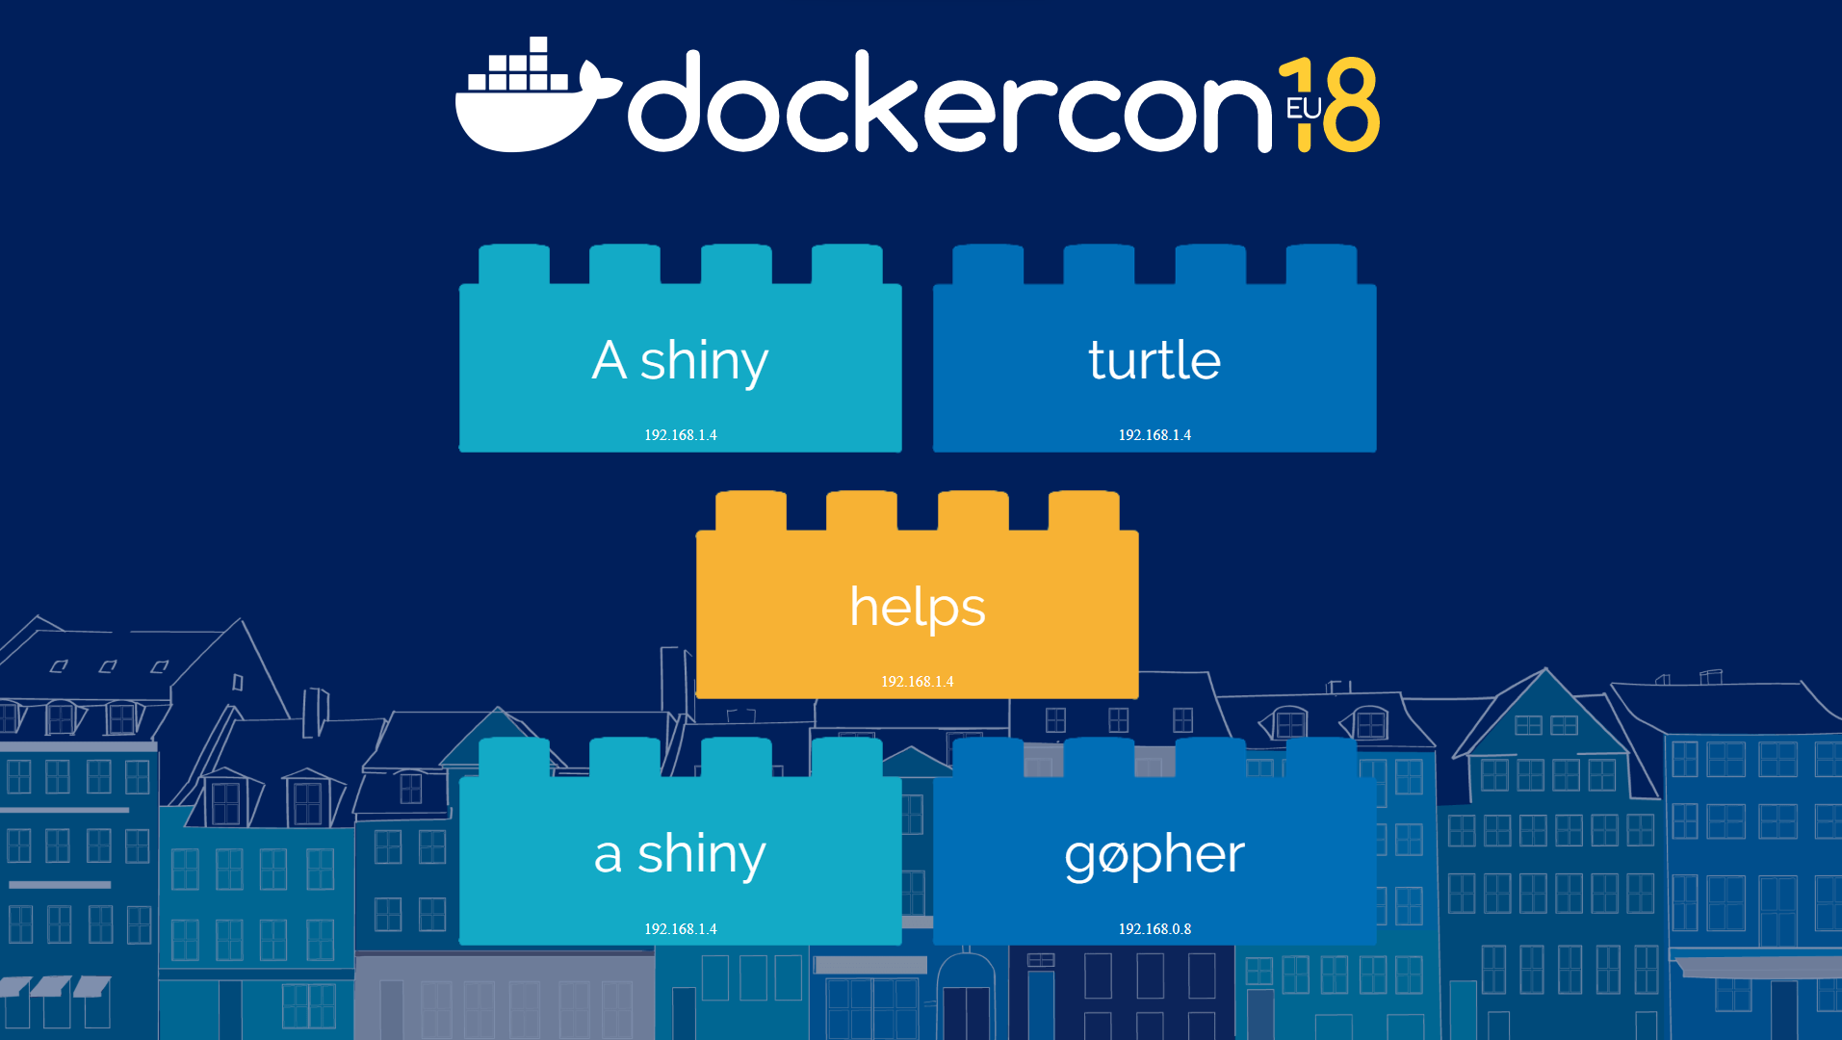
Project

Slide 33
Let’s Hands On

Slide 34
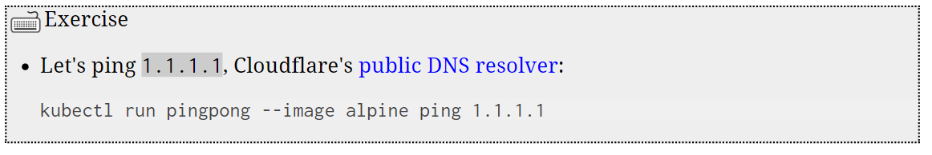
Running our first containers on Kubernetes
Starting a simple pod with kubectl run
$ kubectl run webpage01 –-image devopsdockerhub123/bootcamp:2022
Notes:
kubectl run pingpong --image alpine ping 1.1.1.1
kubectl get all

Slide 35
Hands On
$ Pod
$ Deployments
$ Scaling
$ kubectl explain --recursive
$ kubectl <command> --help
Notes:
kubectl run myweb --image devopsdockerhub123/bootcamp:2022
kubectl expose pod myweb --port=80 --type NodePort

Slide 36
Must Know!
$ kubectl api-resources
$ kubectl api-versions
$ kubectl explain
$ kubectl explain --recursive
$ kubectl cluster-info
$ kubectl <command> --help

Slide 37
Lab – Kubernetes Control
Give us more info about the nodes:
kubectl get nodes -o wide
Let's have some YAML:
kubectl get no -o yaml
See that kind: List at the end? It's the type of our result!

Slide 38
Exploring types and definitions
We can list all available resource types by running
kubectl api-resources
We can view the definition for a resource type with:
kubectl explain <type>
We can view the definition of a field in a resource, for instance:
kubectl explain node.spec
Or get the full definition of all fields and sub-fields:
kubectl explain node --recursive

Slide 39
Exploring types and definitions
We can use kubectl get -o yaml to see all available details
For instance, kubectl get node node1 -o yaml has too much information
For a comprehensive overview, we can use kubectl describe instead

Slide 40
We have created a multi-tier deployment using Postgres as backend database, Java Rest API and the frontend with GO-based Web application. Along with these service to access via frontend

Slide 41

Thank you for giving me the opportunity to present

Slide 43
SlidesCarnival icons are editable shapes.
This means that you can:
Resize them without losing quality.
Change line color, width and style.
Isn’t that nice? :)
Examples:

Slide 44
Diagrams and infographics

